Slide 1

WebSpector:
JavaScript Execution Monitor
20160655 | Minyeop Choi
20150078 | Gyeongwon Kim
20150349 | Jihee Park
Advisor | Sooel Son

Slide 2









Internet Everywhere, Every time !

Slide 3
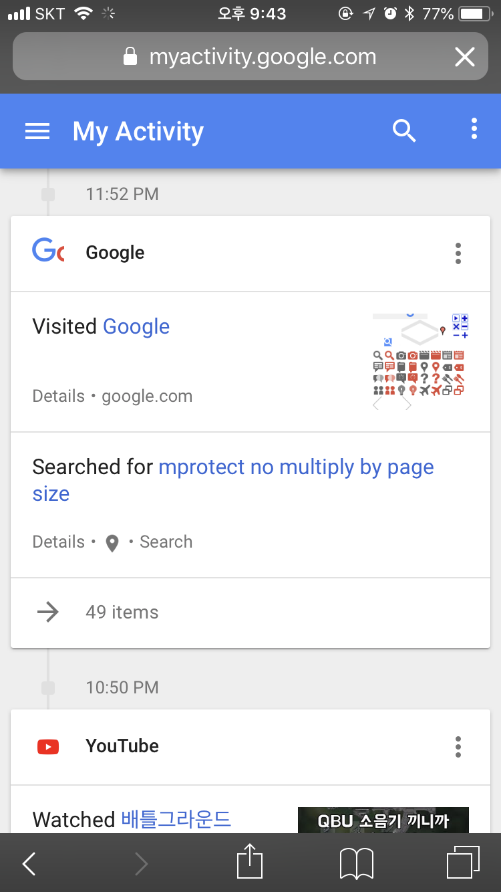
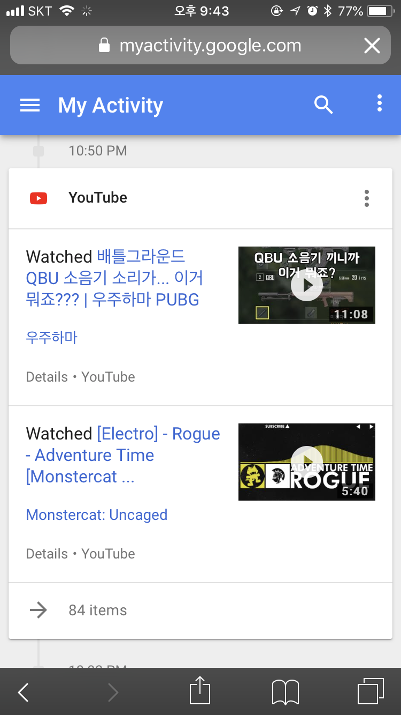
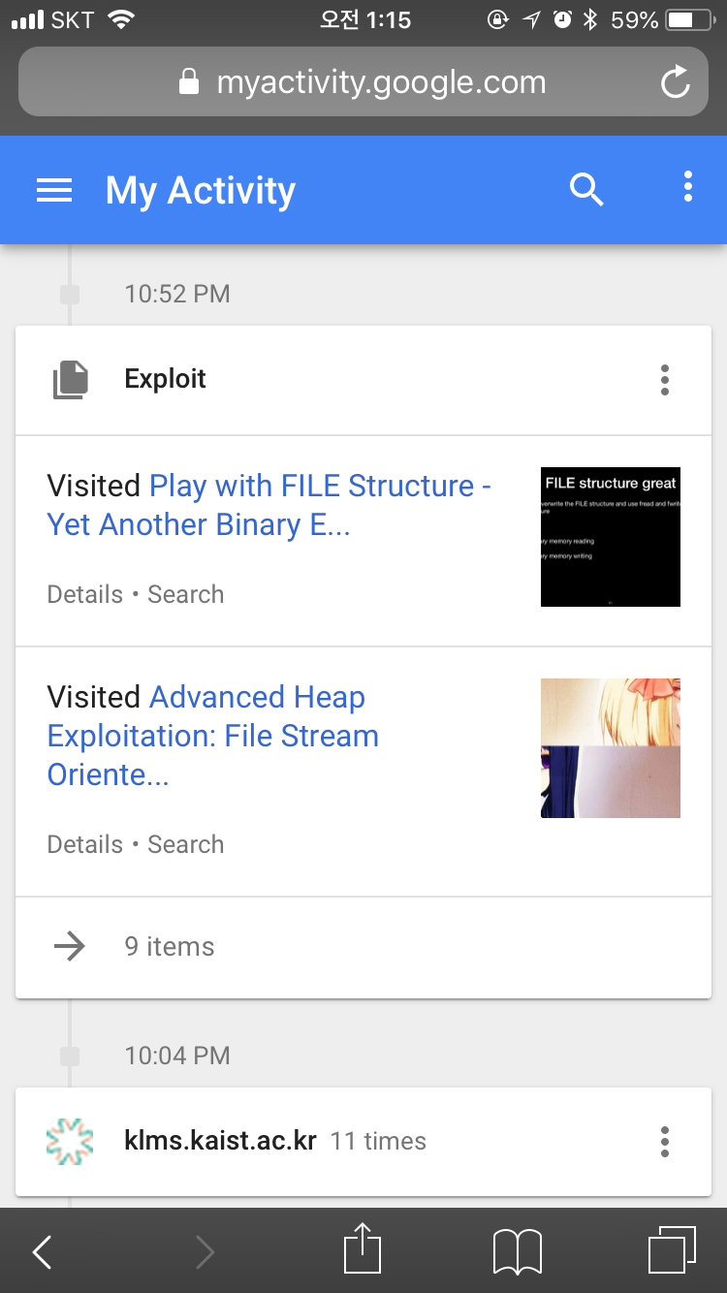
Private data are collected !

Slide 4
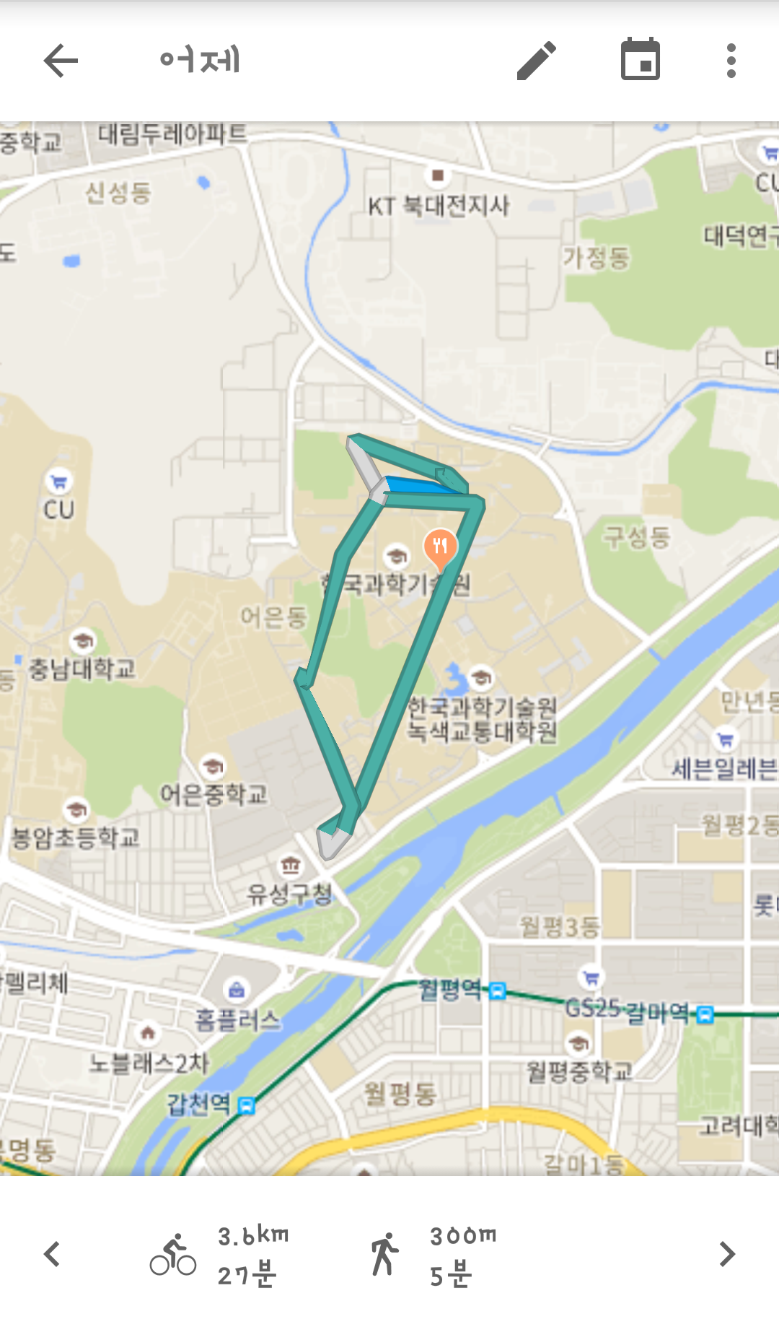
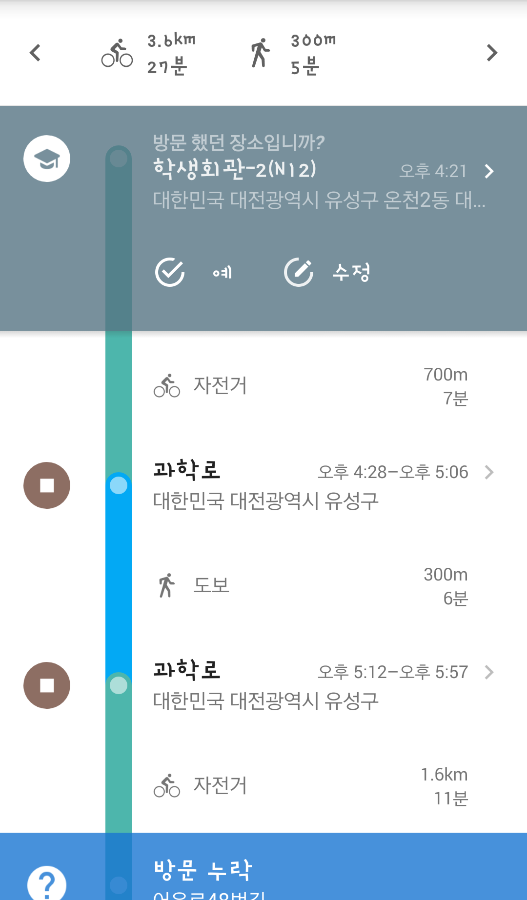
Private data are collected !

Slide 5


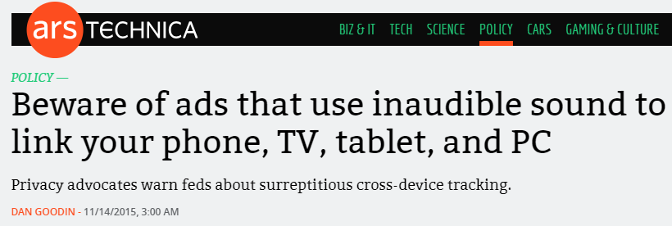
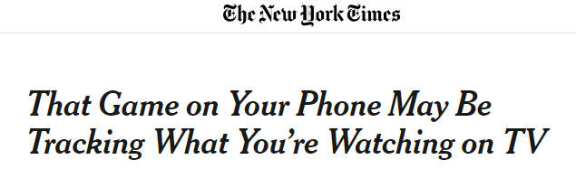
But some websites…

Slide 6
Problem statement
There are no services that detect websites which collect sensitive information

Slide 7

Similar service

Slide 8
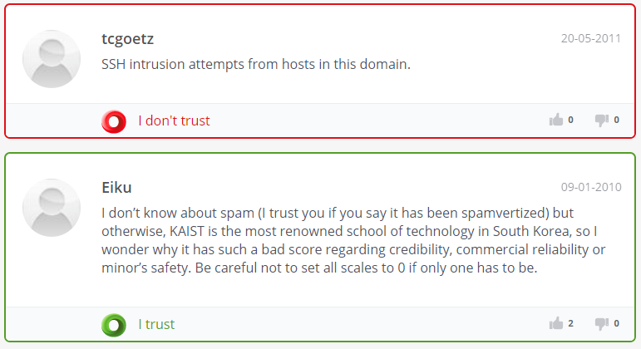
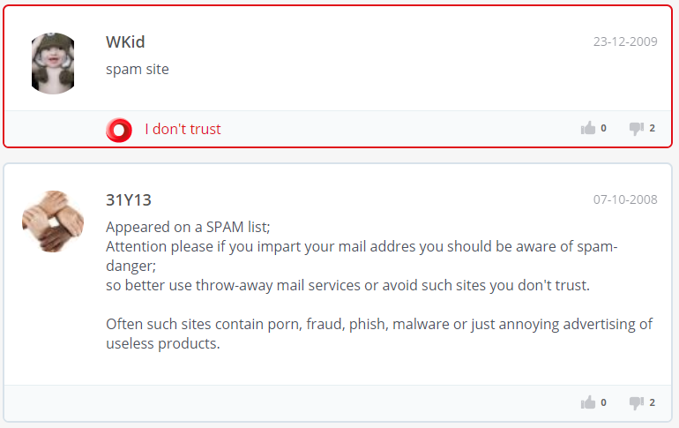
Similar service

Slide 9
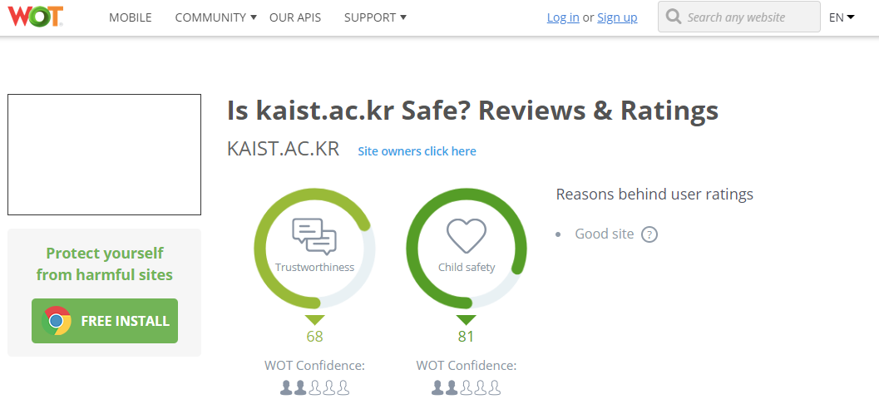
Similar service

Slide 10
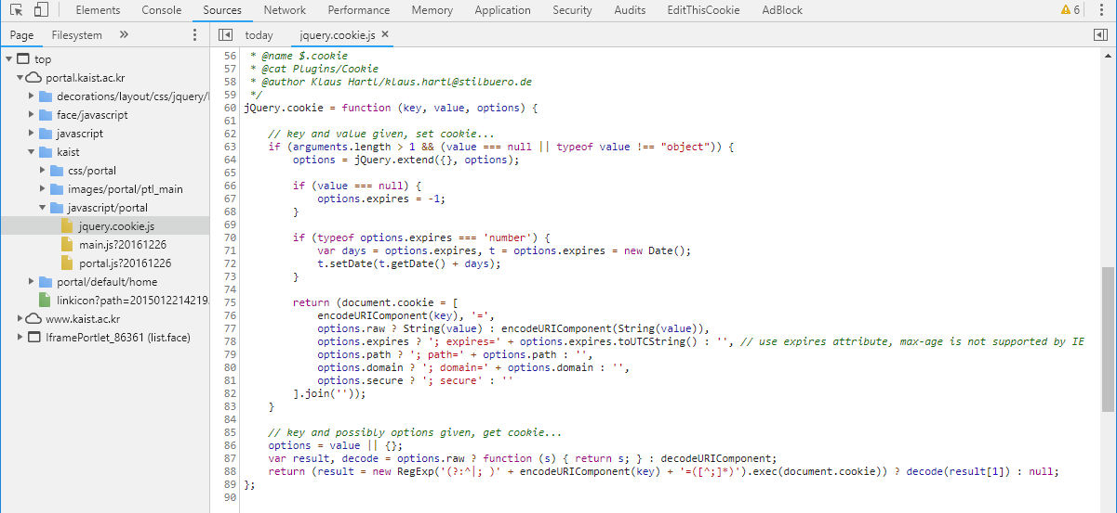

Why not analyze JavaScript files ?

Slide 11

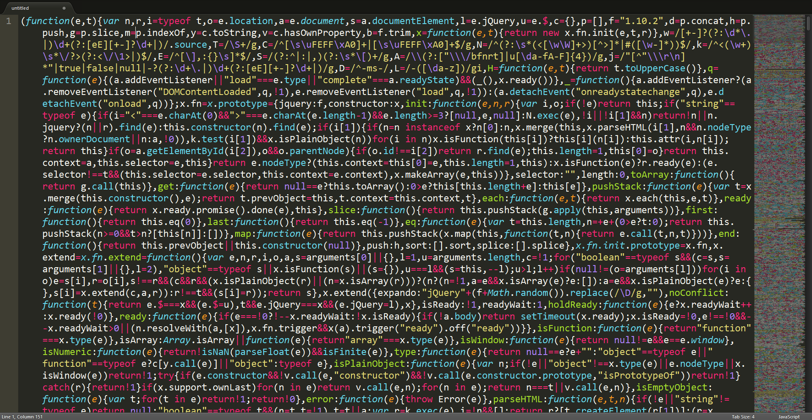
Challenge

Slide 12




Idea
what user see
what actually happens
sensitive data

Slide 13


Idea
what user see
what actually happens
sensitive data
WebSpector

Slide 14







Idea
WebSpector

Slide 15

Idea
WebSpector

Slide 16
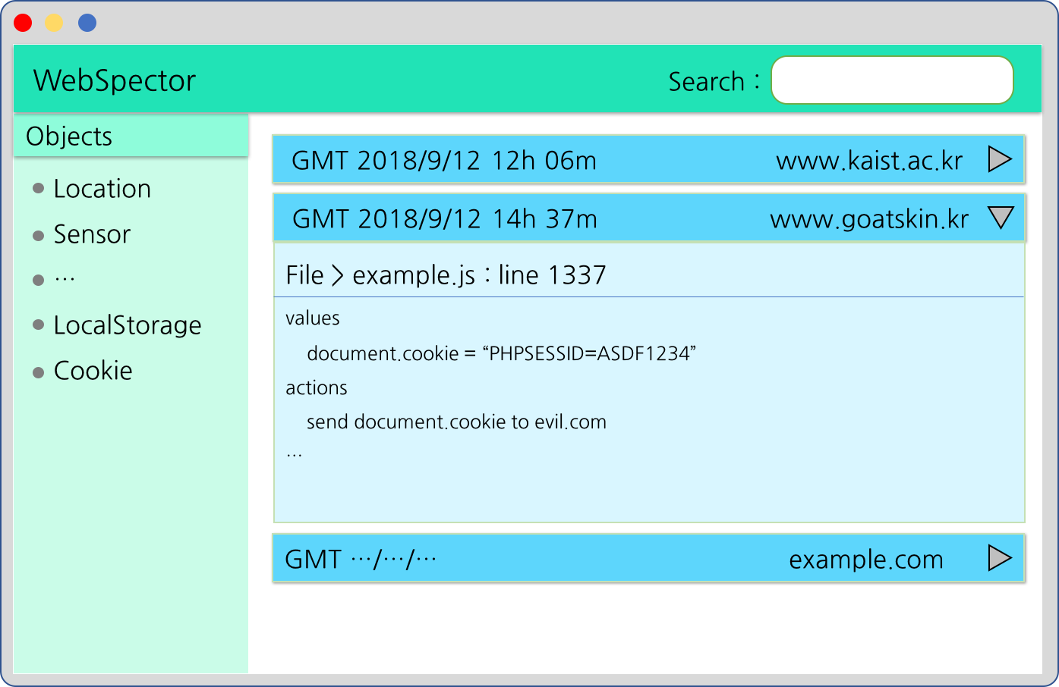
Idea

Slide 17


